Slide 1
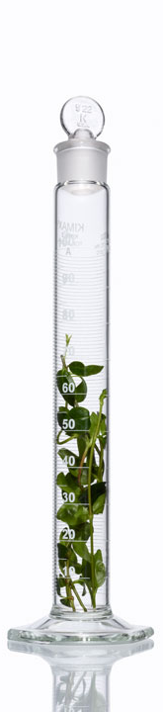
Efficacy and Safety of Glecaprevir/Pibrentasvir in Patients Co-infected with Hepatitis C Virus and Human Immunodeficiency Virus-1: The EXPEDITION-2 Study
Jürgen K Rockstroh¹, Karine Lacombe², Rolando M. Viani³, Chloe Orkin⁴, David Wyles⁵, Anne F Luetkemeyer⁶, Ruth Soto-Malave⁷, Robert Flisiak⁸, Sanjay Bhagani⁹, Kenneth E. Sherman¹⁰, Tatiana Shimonova¹¹, Peter Ruane¹², Joseph Sasadeusz¹³, Jihad Slim¹⁴, Zhenzhen Zhang³, Teresa I. Ng³, Abhishek Gulati³, Roger Trinh³, Mark Sulkowski¹⁵
1. Universitätsklinikum Bonn, Bonn, Germany; 2. Inserm UMR‐S1136, Université Pierre et Marie Curie, Hôpital Saint‐Antoine, APHP, Paris; 3. AbbVie Inc., North Chicago, Illinois, USA; 4. The Royal London Hospital, London, UK; 5. Denver Health Medical Center, Denver, Colorado, United States; 6. Zuckerberg San Francisco General, San Francisco, CA, USA; 7. Innovative Care P.S.C., Bayamon, Puerto Rico; 8. Klinika Chorób Zakaźnych i Hepatologii UM w Białymstoku, Białystok, Poland; 9. Royal Free London Foundation Trust, London, UK; 10. University of Cincinnati, Cincinnati, OH 11 . State budgetary Healthcare Institution Infectious Clinical Hospital #2 of Moscow City Healthcare Department, Moscow, Russia; 12. Ruane Medical & Liver Health Institute, Los Angeles, California, United States; 13. Royal Melbourne Hospital, Parkville,Victoria, Australia; 14. St. Michael’s Medical Center, Newark, NJ, United States; 15. Johns Hopkins University School of Medicine,Baltimore, Maryland, USA
IAS
• Paris, France•
24 July 2017

Slide 2
Disclosures
J Rockstroh: Grant/Research support: Gilead; Consultant/Advisor: Abbott , AbbVie, BMS, Bionor, Cipla, Gilead, Janssen, Merck, ViiV; Speaker at educational events: BMS, Gilead, Janssen, Merck.
K Lacombe: Advisor/Consultant/Speaker boards: AbbVie, BMS, Gilead, Janssen, Merck.
C Orkin: Grant/Research support: AbbVie, Abbott , Boehringer Ingelheim, BMS, Gilead, GSK, Janssen, ViiV.
D Wyles: Grant/Research support: AbbVie, Gilead, Merck, Tacere Therapeutics; Consultant/Advisor: AbbVie, Gilead, Merck.
A Luetkemeyer: Grant/Research support: AbbVie, BMS, Gilead, Merck.
R Soto-Malave: Grant/Research support: AbbVie; Consultant/Advisor for Janssen, Merck.
R Flisiak: Consultancy/Advisory board/Speaker: AbbVie, Alfa Wasserman, BMS, Gilead, Janssen, Merck, Roche.
S Bhagani: Advisor/Consultant/Speaker boards: Abbvie, BMS, Gilead, Janssen, Merck, ViiV. KE Sherman: Grant/Research support (Paid to institution): AbbVie, Merck, Gilead, BMS, Innovio, Intercept. Advisory board (paid to institution): Merck, MedImmune.
T Shimonova: Investigator for AbbVie. P Ruane: Grant/Research support: AbbVie, BMS, Gilead, Merck, Idenix, ViiV, Janssen; Consultant/Advisor: AbbVie, Merck, Gilead; Speaker: Gilead, ViiV, Merck; Stockholder: Gilead.
J Sasadeusz: Advisory boards: AbbVie, Gilead , Merck, BMS. Research support: Gilead, AbbVie. Speaker: Gilead, BMS.
J Slim: Speaker for AbbVie, BMS, Gilead, Merck, Janssen, Genentech.
M Sulkowski: Consultant/Advisor: AbbVie, Cocrystal, Gilead, Janssen, Trek; Data safety monitoring board: Gilead (funds paid to Johns Hopkins University; Grant/Research support: AbbVie, Gilead, Merck, Janssen (paid to Johns Hopkins University).
RM Viani, Z Zhang, TI Ng, A Gulati , NS Shulman, and R Trinh: Employees of AbbVie Inc., and may hold stock or options.
Medical writing support was provided by Zoë Hunter, PhD, of AbbVie.
AbbVie sponsored the study (NCT02640482), contributed to its design, participated in the collection, analysis, and interpretation of data, and in the writing, reviewing, and approval of the publication.

Slide 3
Background
In phase 2 & 3 studies, over 1900 patients with hepatitis C virus (HCV) genotype (GT) 1–6 infection without cirrhosis achieved rates of sustained virologic response 12 weeks post-treatment (SVR12) of 93–100% with all-oral, once-daily, ribavirin-free, pangenotypic glecaprevir/pibrentasvir (G/P)^{1–3}
100% (33/33) of HCV GT1/HIV-1 co-infected patients without cirrhosis achieved SVR12 following 8- or 12- week treatment with G/P, a ritonavir-free regimen¹
Zeuzem et al, Abstract #253 AASLD 2016.
Kwo, et al, J Hepatology, 2017.
Puoti et al. Abstract SAT 233, EASL 2017

Slide 4
Next Generation Direct-Acting Antivirals
GLE
PIB
Glecaprevir
(formerly ABT-493)
pangenotypic NS3/4A protease inhibitor
Pibrentasvir
(formerly ABT-530) pangenotypic NS5A inhibitor
Coformulated: G/P
In vitro:^{1, 2} | High barrier to resistance
 | Potent against common NS3 polymorphisms (e.g., positions 80, 155, and 168) and NS5A polymorphisms (e.g., positions 28, 30, 31 and 93)
 | Synergistic antiviral activity
Clinical PK & metabolism: | Once-daily oral dosing with food
 | Minimal metabolism and primary biliary excretion
 | Negligible renal excretion (<1%)
G/P is co-formulated and dosed once daily as three 100 mg/40 mg pills for a total dose of 300 mg/120 mg.
Glecaprevir was identified by AbbVie and Enanta. 1. Ng TI, et al. Antimicrobial Agents and Chemotherapy, 2017. 2. Ng TI, et al. Abstract 636. CROI, 2014

Slide 5
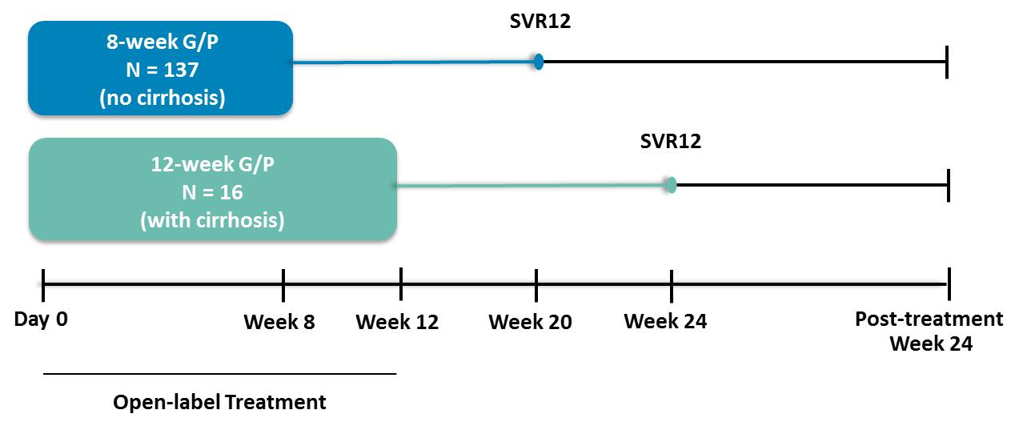
EXPEDITION-2 Study Design
  A phase 3, multicenter global study evaluating 8- or 12-week treatment with G/P in HCV/HIV-1 co-infected adults without or with compensated cirrhosis, respectively
Patients were enrolled in Australia, Belarus, France, Germany, Poland, Puerto Rico, Russian Federation, United Kingdom and United States
G/P is co-formulated and dosed once daily as three 100 mg/40 mg pills for a total dose of 300 mg/120 mg.

Slide 6
Key Eligibility Criteria
Key inclusion criteria
  ≥ 18 years of age (no upper limit)
  BMI ≥18.0 kg/m² (no upper limit)
    Chronic HCV infection with GT 1, 2, 3, 4, 5, or 6 (HCV RNA ≥1000 IU/mL) and a positive test result for anti -HIV-1 antibody
HCV treatment-naïve or treatment-experienced with IFN or pegIFN ± RBV, or SOF + RBV ± pegIFN
Key exclusion criteria
Prior HCV treatment experience with a DAA other than SOF
  HBV coinfection
  Abnormal laboratory values
Absence or presence of cirrhosis documented by liver biopsy or:
Abnormal laboratory values
 | Without Cirrhosis | With Cirrhosis
Fibroscan or | <12.5 kPa | ≥12.5 kPa
FibroTest and APRI | ≤0.48 + <1 | ≥0.75 + >2
For discordant cases, cirrhosis status was dictated by FibroScan results.
Assessment | Value
ALT | >10 × ULN
AST | >10 × ULN
Albumin | < 3.0 g/dL
CrCl | < 50 mL/min
Platelets, cells/mm³ | < 60,000 (cirrhosis)
 | < 90,000 (no cirrhosis)
IFN, interferon; pegIFN, pegylated IFN; RBV, ribavirin; SOF, sofosbuvir; DAA, direct-acting antiviral; ALT, alanine aminotransferase; AST, aspartate aminotransferase; CrCl, creatinine clearance

Slide 7
Antiretroviral therapy (ART) requirements
Antiretroviral therapy (ART) naïve with CD4+ count ≥500 cells/mm³ or ≥29%
Or
On a stable ART regimen for at least 8 weeks prior to screening*:
*CD4+ count ≥200 cells/mm³ or ≥14%, and plasma HIV-1 RNA <LLOQ

Slide 8
Study Endpoints
Primary Endpoint
SVR12 (HCV RNA <15 IU/mL 12 weeks post-treatment)
Non-inferiority (6% margin) to 96% SVR12 rate with historical standard of care*
Secondary Endpoints
  On-treatment virologic failure and post-treatment relapse
  Additional Assessments
  Adverse events (AEs) and laboratory abnormalities
  Next generation sequencing (detection threshold 15%) to identify baseline polymorphisms and treatment emergent substitutions in NS3 and NS5A
  *Sofosbuvir + ledipasvir or grazoprevir/elbasvir; non-inferiority will be achieved if the lower confidence bound of the 95% confidence interval for SVR12 is >90%

Slide 9
Baseline Demographics & Disease Characteristics

Slide 10
Baseline Demographics & Disease Characteristics
Notes:
F2: N=2 patients (1%) in 8 week arm. F0-F1 N= 120 (88%).

Slide 11
Baseline Demographics & Disease Characteristics
Notes:
Amendments to add Elvitegravir, DRV, Lopinavir came later; could account for low enrollment

Slide 12
Baseline Polymorphisms*
Sequence, n (%) | Without Cirrhosis 8 Weeks N = 130† | With Cirrhosis 12 Weeks N = 16
None | 92 (71) | 9 (56)
NS3 only | 1 (<1) | 1 (6)
NS5A only | 36 (28) | 6 (38)
NS3 + NS5A | 1 (<1) | 0
*Baseline polymorphisms detected at 15% next generation sequencing threshold at a key subset of amino acid positions NS3: 155, 156, 168 NS5A: 24, 28, 30, 31, 58, 92, 93 †N representative of samples that had sequences available for both targets
Baseline polymorphisms at amino acid positions associated with resistance for currently approved DAAs

Slide 13
Efficacy
One patient with GT3 infection and cirrhosis had on-treatment virologic failure at week 8; the patient was 85% compliant with treatment
*Patient returned at post-treatment week 24 and had achieved SVR
Notes:
mITT in 8-week (no cirrhosis): 100% (136/136)
mITT in 12-week (cirrhosis): 93% (14/15)

Slide 14
Summary of Adverse Events (AE)
Event, n (%) | Without Cirrhosis 8 Weeks N = 137 | With Cirrhosis 12 Weeks N = 16
Any AE | 86 (63) | 8 (50)
AEs leading to study drug discontinuation | 0 | 1 (6)†
Serious AEs | 3 (2)* | 1 (6)†
DAA-related serious AE | 0 | 0
AEs occurring in ≥5% total patients
Fatigue | 18 (13) | 0
Nausea | 12 (9) | 1 (6)
Headache | 12 (9) | 0
Nasopharyngitis | 12 (9) | 0
*Upper GI hemorrhage, obliterating arteriopathy, and urolithiasis in one patient each, all unrelated to G/P
†One GT2-infected patient with cirrhosis experienced serious AEs unrelated to G/P of cerebrovascular accident and cerebral hemorrhage on Day 23 that led to discontinuation of study drug; the patient did not achieve SVR12

Slide 15
Laboratory Abnormalities
Characteristic, n (%) | Without Cirrhosis 8 Weeks N = 137 | With Cirrhosis 12 Weeks N = 16
AST Grade ≥3 (>5 × ULN) | 0 | 0
ALT Grade ≥3 (>5 × ULN) | 0 | 0
Total Bilirubin, Grade ≥3 (>3 × ULN) | 1 (0.7) | 0
ALT, alanine aminotransferase; AST, aspartate aminotransferase; ULN, upper limit of normal
One patient had a Grade 3 total bilirubin elevation on Day 10 through Day 31; levels normalized by Day 59 without treatment interruption
No patients met pre-specified criteria for failure to maintain HIV RNA suppression during the Treatment Period

Slide 16
Summary
98% overall SVR12 with no relapses in HCV/HIV-1 coinfected patients without or with cirrhosis following 8 or 12 weeks of G/P, respectively
SVR12 was not impacted by high baseline viral load, cirrhosis status, or any other baseline factor
Non-inferiority to historical standard of care was achieved
G/P was well tolerated and had a similar safety profile in HCV/HIV-1 coinfected patients with or without cirrhosis; serious adverse events, clinically significant laboratory abnormalities, and treatment discontinuations were rare
99% SVR12 rate with no virologic failures with 8-week G/P in HCV/HIV-1 co-infected patients without cirrhosis

Slide 17
Conclusion
These results suggest that the G/P regimen could be the first 8-week, pangenotypic treatment option for HCV/HIV-1 coinfected patients without cirrhosis

Slide 18
Acknowledgement
The authors would like to express their gratitude to the patients who participated in this study and their families, and all the study investigators and their staff.

Slide 20
Resistance Information on the One Patient with Virologic Failure
Target | Baseline | Time of Failure
NS3 | None | Y56H
NS5A | A30V | S24F, M28K

Slide 21
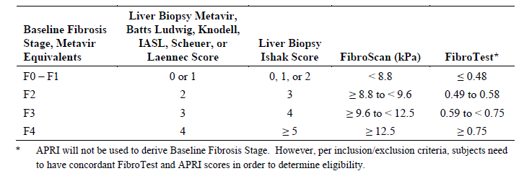
Algorithm for Cirrhosis Determination
Only one score will be used to categorize each patient, even if a patient has more than one score recorded. If a biopsy score is present, then it will be used to categorize the patient, regardless of the FibroScan/FibroTest score.
Similarly, if a FibroScan score is present along with a FibroTest score, then the FibroScan score will be used to categorize the patient. If biopsy and FibroScan scores are not present and more than one FibroTest result is available, then the baseline FibroTest result will be used to categorize the patient.

Slide 22
Changes in ARV and G/P Exposures when Co-administered
Regimen | Analyte | C_{max} | AUC | C_{trough}
EFV/FTC/TDF | Efavirenz | ↔ | ↔ | ↔
 | Emtricitabine | ↔ | ↔ | ↔
 | Tenofovir | ↔ | ↑ 29% | ↑ 38%
ABC/DTG/3TC | Abacavir | ↔ | ↔ | ↑ 31%
 | Dolutegravir | ↔ | ↔ | ↔
 | Lamivudine | ↔ | ↔ | ↔
EVG/COBI/ FTC/TAF | Elvitegravir | ↑ 36% | ↑ 47% | ↑ 71%
 | Cobicistat | ↑ 29% | ↑ 42% | ↑ 72%
 | Emtricitabine | ↔ | ↔ | ↔
 | Tenofovir | ↔ | ↔ | ↔
RPV | Rilpivirine | ↑ 105% | ↑ 84% | ↑ 77%
RAL | Raltegravir | ↑ 34% | ↑ 47% | ↑ 164%
ATZ + RTV | Atazanavir | ↔ | ↔ | ↔
 | Ritonavir | ↔ | ↑ 30% | ↑ 26%
DRV + RTV | Darunavir | ↑ 30% | ↑ 29% | ↔
 | Ritonavir | ↑ 103% | ↑ 87% | ↔
LPV/RTV | Lopinavir | ↔ | ↔ | ↑ 47%
 | Ritonavir | ↔ | ↔ | ↑ 38%
Regimen | Analyte | C_{max} | AUC | C_{trough}
EFV/FTC/TDF | GLE | ↓* | ↓* | ↓*
 | PIB | ↓* | ↓* | ↓*
ABC/DTG/3TC | GLE | ↓ 26% | ↓ 25% | ↔
 | PIB | ↓ 26% | ↓ 28% | ↓ 27%
EVG/COBI/ FTC/TAF | GLE | ↑ 150% | ↑ 205% | ↑ 358%
 | PIB | ↑ 24% | ↑ 57% | ↑89%
RPV | GLE | ↔ | ↔ | ↔
 | PIB | ↔ | ↔ | ↔
RAL | GLE | ↔ | ↔ | ↔
 | PIB | ↔ | ↔ | ↔
ATZ + RTV‡ | GLE | ↑ 306% | ↑ 553% | ↑ 1330%
 | PIB | ↑ 29% | ↑ 64% | ↑ 129%
DRV + RTV | GLE | ↑ 209% | ↑ 397% | ↑ 724%
 | PIB | ↔ | ↔ | ↑ 66%
LPV/RTV | GLE | ↑ 155% | ↑ 338% | ↑ 1762%
 | PIB | ↑ 40% | ↑ 146% | ↑ 424%
*Central value ratios were not calculated. G/P exposures were significantly lower than in other studies in healthy subjects. ‡Effect of first ATZ + RTV dose. Greater increases with multiple doses cannot be excluded.

Slide 23
DDI Summary by HIV ARV and DAA Regimen
Agent | Viekira | Harvoni | Epclusa | Zepatier | SOF/VEL/VOX |  | GLE/PIB
Abacavir | ◊ | ◊ | ◊ | ◊ | ◊ |  | ◊
Atazanavir | □ | ◊ | ◊ | X | X* |  | X
Darunavir (boosted) | □ | ◊ | ◊ | X | ◊ |  | ○
Dolutegravir | ◊ | ◊ | ◊ | ◊ | ◊ |  | ◊
Efavirenz | X | □ | ○ | X | ○* |  | ○
Elvitegravir/cobi | X | ◊ | ◊ | ◊ | ◊ |  | ◊
Emtricitabine | ◊ | ◊ | ◊ | ◊ | ◊ |  | ◊
Lamivudine | ◊ | ◊ | ◊ | ◊ | ◊ |  | ◊
Lopinavir | X | □ | ◊ | X | ○* |  | ○
Raltegravir | ◊ | ◊ | ◊ | ◊ | ◊ |  | ◊
Rilpivirine | □ | ◊ | ◊ | ◊ | ◊ |  | ◊
TAF | □ | ◊ | □ | ◊ | ◊ |  | ◊
TDF | ◊ | □ | □ | ◊ | □ |  | □
Coding based on present or anticipated Liverpool database classification
*Expected based on DDI with similar mechanism | ◊ - No dose adjustment | □ - Dose adjustment or caution | ○ - Not recommended | X - Contraindicated

